Slide 1
Service Discovery -Eureka Cloud Server
JananI

Slide 2
Discover Services
Spring Cloud Consul
Spring Cloud Zookeeper
Spring Cloud Netflix

Slide 3
Spring Cloud Netflix
Spring Cloud Netflix
=
Netflix OSS + Spring +Spring Boot

Slide 4
Key Components
Discovery Server
Service
Client

Slide 5
Interaction Between Key Components
Step #1 Service Register its location
Step #2 Client looks up service location
Step #3 Discovery Server sends back location
Step #4 Client requests services at location
Step #5 Service sends response

Slide 6
Discovery Server
An actively managed registry of service locations
It is implemented within the Spring Cloud Eureka Server Project

Slide 7
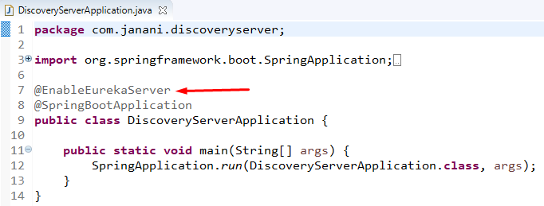
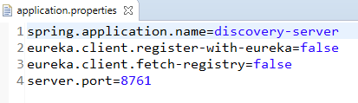
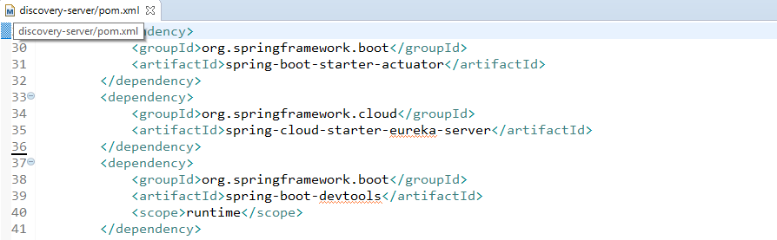
Demo : Setting up a Service Discovery Server
Eureka Server

Slide 8
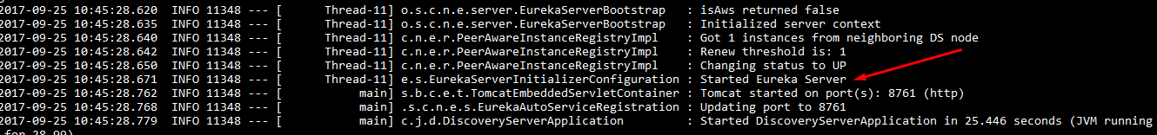
Execute Discovery Server

Slide 9
Application Service
Provides application functionality
User of the discovery client to call out to the discovery server & register & deregister itself

Slide 10
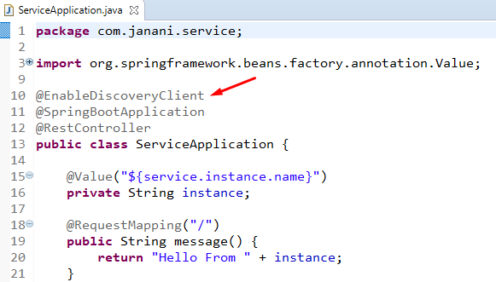
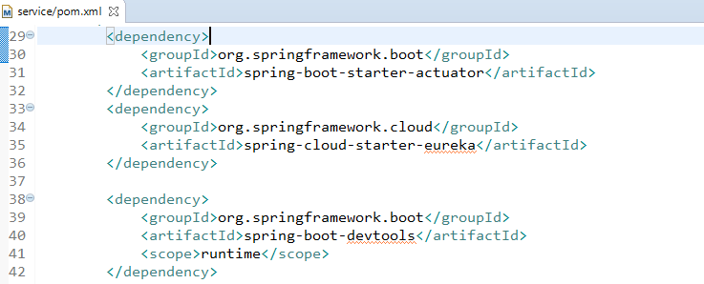

Demo: Making an Application Service Discoverable
Location of Service Discovery Server

Slide 11
Execute Application Service - Instance 1

Slide 12
Execute Application Service - Instance 2

Slide 13
Application Client
Issuer of requests
User of the discovery client to find service locations

Slide 14
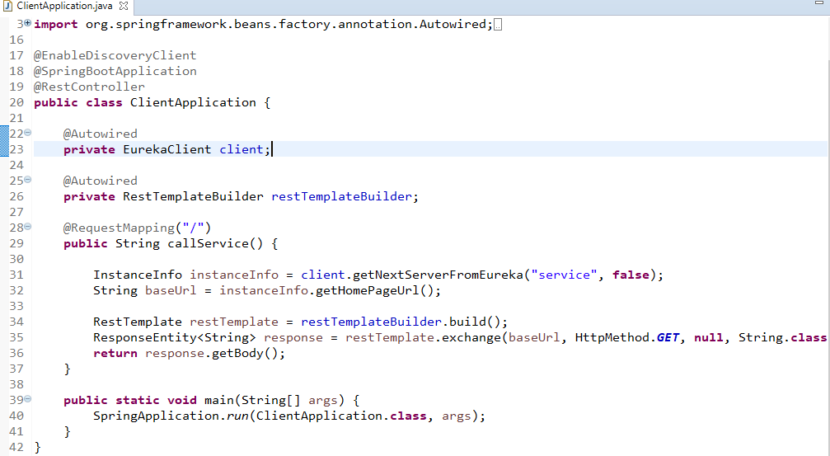
Demo: Finding & Calling Services as an Application Client

Slide 15

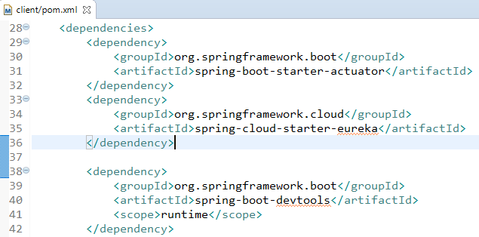
Demo: Finding & Calling Services as an Application Client

Slide 16
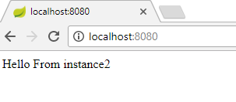
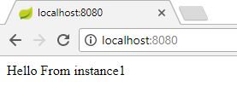
Execute Application Client

Slide 17
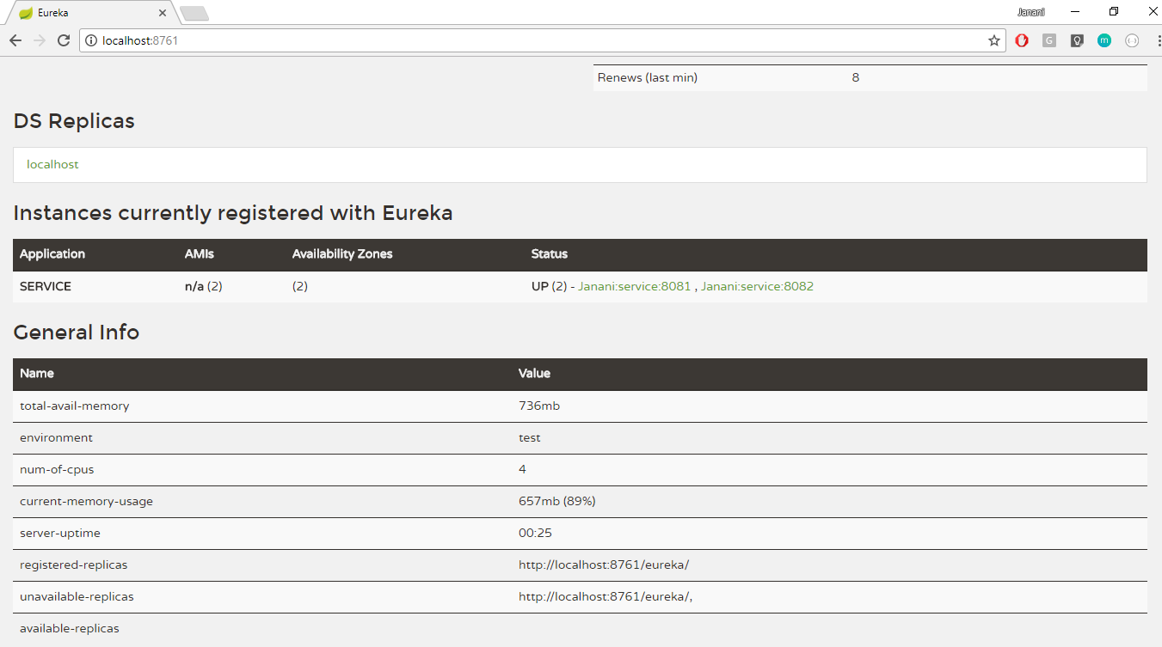
Eureka Dashboard

Slide 18
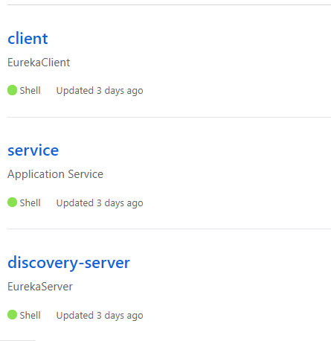
Thank You
Github Repositries
https://github.com/JananiVelmurugan

